Slide 1

Student Innovation : Inclusive TravelMate: Empowering Accessible and Thriving Tourism

Slide 2

IDEA TITLE
Creation of a multi-functional platform to revitalize the tourism industry by offering a seamless and inclusive experience for all travelers, with a focus on those with disabilities.
Provision of tools and resources to help travelers plan trips, book accommodations, and explore destinations confidently, ensuring that their accessibility needs are met.
Support for tourism businesses in enhancing their services to be more inclusive, thereby boosting their market reach and customer satisfaction.
Emphasis on accessibility by ensuring that tourist destinations, products, and services are accessible to all people, regardless of physical limitations, disabilities, or age.
Promotion of thriving tourist centers that are lively and profitable.
Implementation of a personalized form for users to specify their disability-related needs, allowing hotel staff to prepare for the guest's stay, regardless of the size or nature of the request.

Slide 3
IDEA TITLE
Introduction of QR codes at famous monuments and architectural sites to provide detailed information to tourists, with an option to translate the information into the tourist's preferred language.
Encouragement of the use of CNG and EV vehicles for tourist transportation, which is both cost-effective and environmentally friendly.
Directly addressing the needs of disabled tourists by enabling them to specify the services required, ensuring a comfortable stay at hotels.
Innovative and unique approach by allowing users to inform hotel staff about their specific needs, facilitating better preparation for their stay.
QR code feature at tourist spots to enhance understanding of history and culture, with a translation option for improved accessibility.
Focus on environmental sustainability through the promotion of CNG and EV vehicles in tourism.

Slide 4

TECHNICAL APPROACH
We’ll use HTML to structure the content and make sure everything is accessible.
We’ll apply CSS to ensure the platform looks good and works well on any device.
JavaScript will add interactivity, so users can experience dynamic content without reloading pages.
Node.js will handle all the backend processes, making sure the server-side logic runs smoothly.
With Express.js, we’ll build the backend services and APIs that power the platform’s functionalities.
ReactJS will help us create a fast and responsive user interface that’s easy to navigate.
Google Maps API will be integrated for interactive maps, helping users find accessible routes.
We’ll use OpenStreetMap to offer customizable, community-driven mapping data.
Our design will be user-centered, ensuring that everything is easy to use and accessible.
We’ll integrate APIs to bring in external data and services, enriching the platform’s features.
Geo-spatial data will power location-based services, helping users find accessible options nearby.

Slide 5
TECHNICAL APPROACH
AI and Machine Learning will personalize the experience, recommending options based on user preferences.
We’ll include crowdsourcing tools so the community can contribute information about accessible locations.
We’ll start by gathering and analyzing user needs, with a special focus on accessibility.
Next, we’ll develop wireframes and prototypes, then build the frontend to be responsive and user-friendly.
On the backend, we’ll set up all the server-side logic, APIs, and user authentication systems.
We’ll also implement mapping services to provide location-based features.
AI models will be integrated to offer personalized recommendations to users.
Crowdsourcing will allow users to contribute valuable accessibility data.
We’ll rigorously test the platform to ensure it’s easy to use, accessible, and performs well.
Finally, we’ll deploy the platform and maintain it, scaling as needed and continuously improving based on user feedback.
Throughout the process, we’ll develop prototypes to gather feedback and refine the platform’s features.

Slide 6

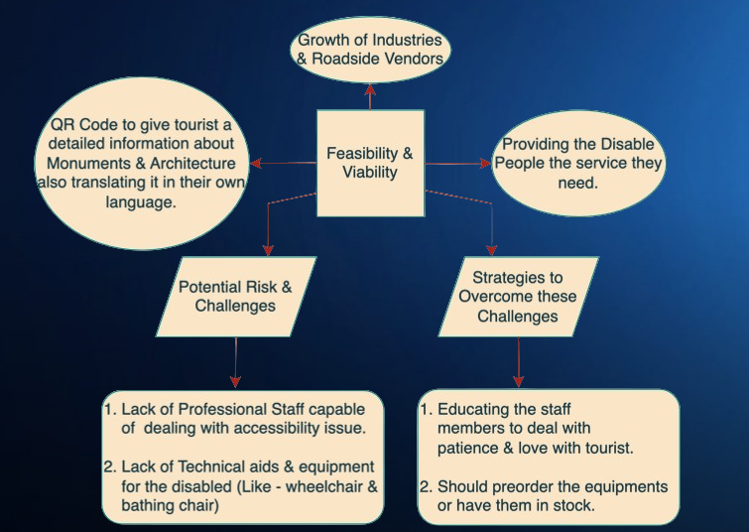
FEASIBILITY AND VIABILITY

Slide 7
FEASIBILITY AND VIABILITY

Slide 8

IMPACT AND BENEFITS
Impacts –
Rise in their income
Establishing of business branches
Country’s economic growth will rise
Tourism can provide with the full-time income to vendors & sometimes it does not provide.

Slide 9
IMPACT AND BENEFITS
Benefits of the solution-
Will bring employment
Rise in economy rate
No air pollution
Spreading our culture around the eyes of the world
Industries development

Slide 10

RESEARCH AND REFERENCES
Links of the reference and research work –
https://empowermenttourism.com/empowerment-tourism/#:~:text=For%20us%2C%20Empowerment%20Tourism%20is,the%20opportunities%20we%20can%20provide.
https://single-market-economy.ec.europa.eu/sectors/tourism/eu-funding-and-businesses/business-portal/accessibility_en#:~:text=Accessible%20tourism%20is%20about%20making,the%20competitiveness%20of%20tourism%20businesses.

Slide 11


